Slide 1
Home Credit Default Risk
Erica Augustyniak
Karim Al Zere Alhusaini
Kindeep Dhatt
Mathai Paul

Slide 2
Outline
Data cleaning
EDA
Models
Log Regression
LDA
QDA
Random Forest
kNN
Conclusion

Slide 3
Data
Source: Kaggle Competition
Bank loan data with characteristics about client
307,511 records (loans) in the data set
Loans include installment loans and revolving credit
122 variables, trimmed down to 22 (many were not important/easy to interpret)
TARGET variable: binary, indicates client default status
Winning Competition had 0.81 AUC

Slide 4
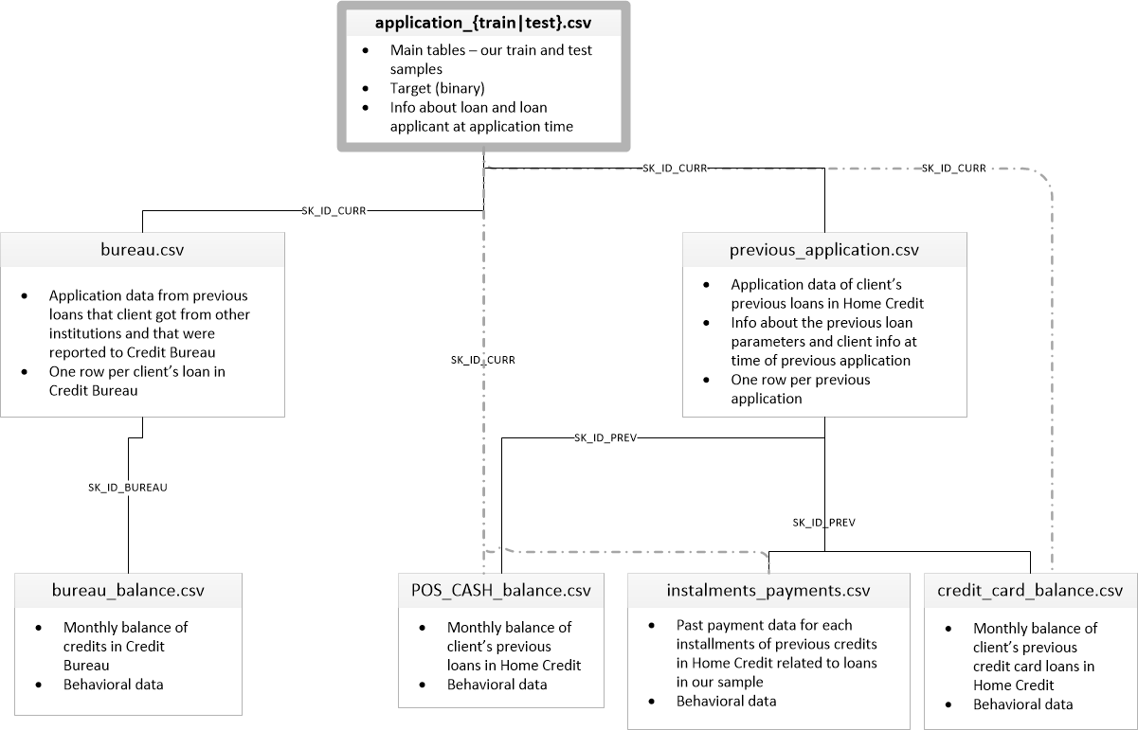
Data

Slide 5
Tools
R Studio: model building and analysis
Python: EDA
SQL: data management and cleaning
Tableau: EDA

Slide 6
8.04%
Overall Default Rate

Slide 7
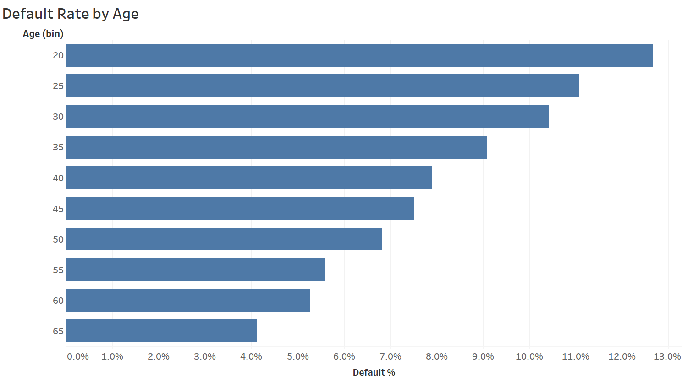
Exploratory Data Analysis

Slide 8
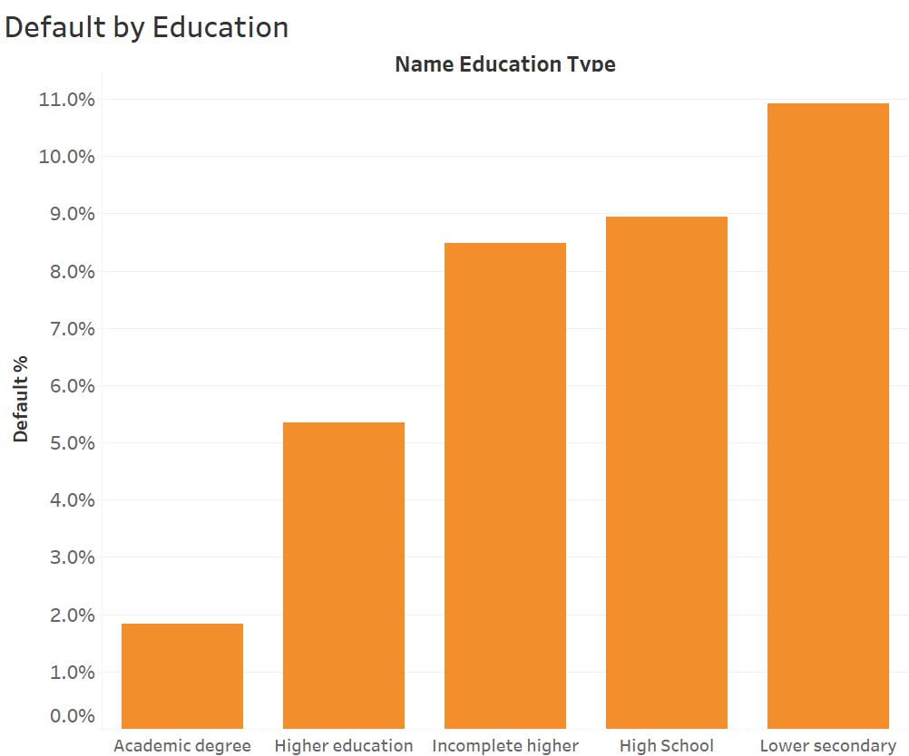
Exploratory Data Analysis

Slide 9
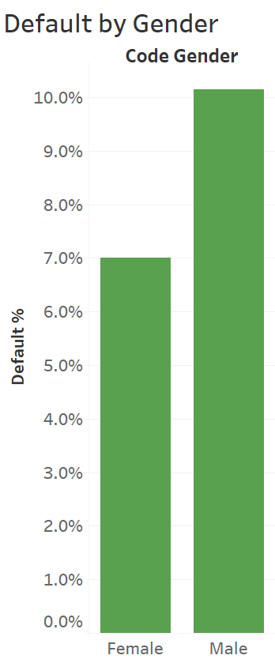
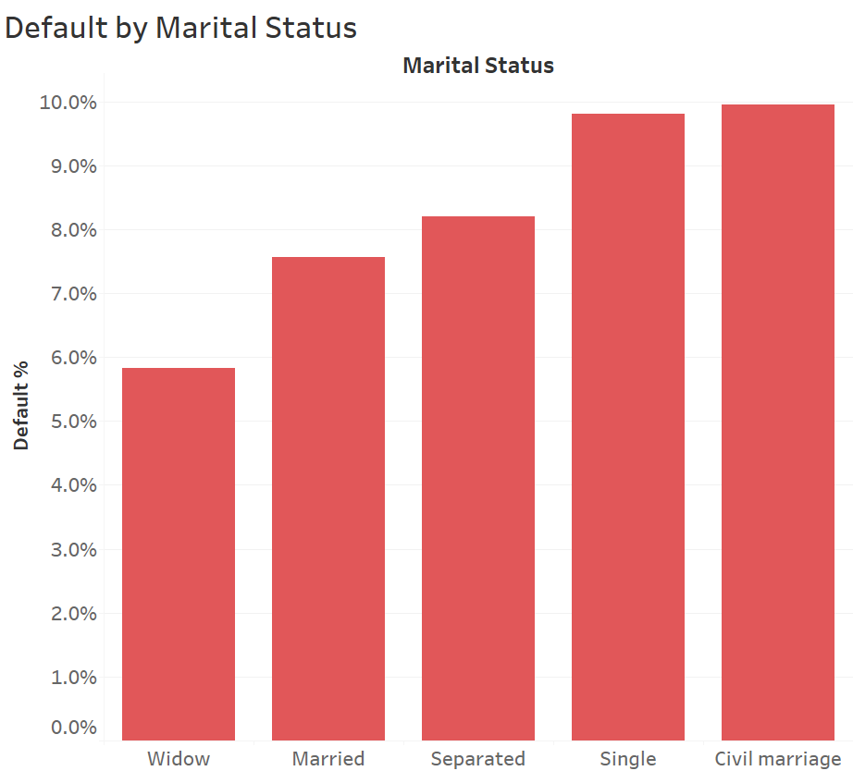
Exploratory Data Analysis

Slide 10
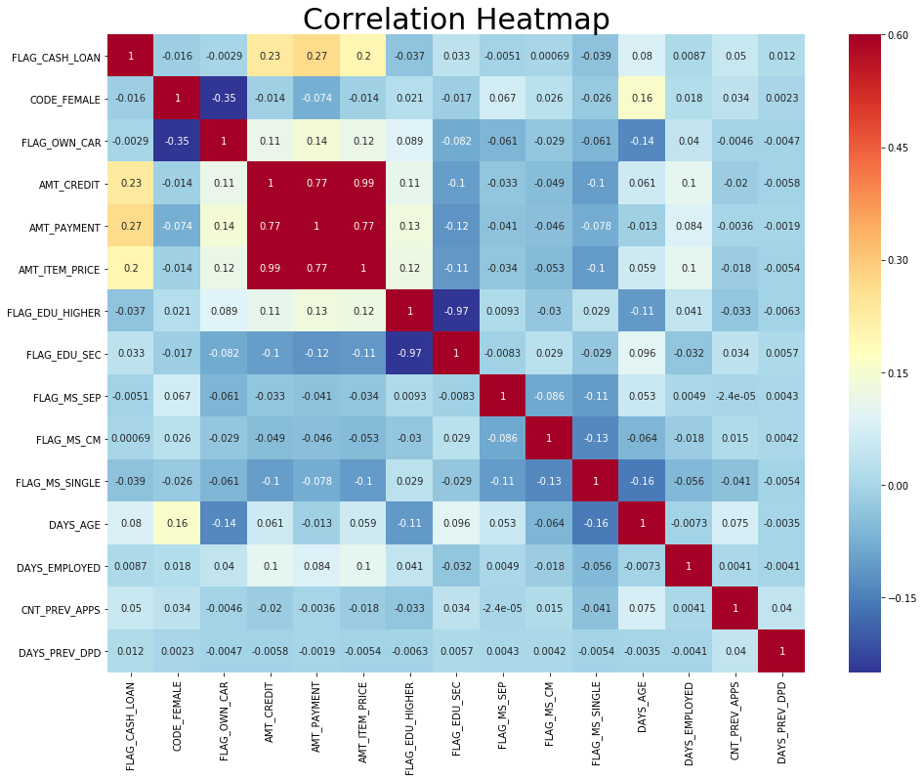

Slide 11
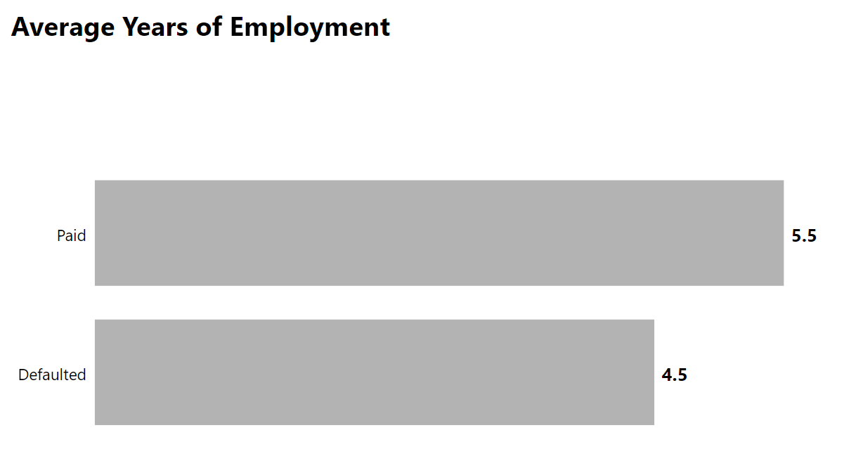
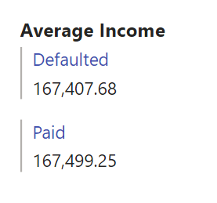

Slide 12
Variables Used
TARGET(0,1) ~ FLAG_CASH_LOAN + CODE_FEMALE + FLAG_OWN_CAR +
AMT_CREDIT + AMT_PAYMENT + AMT_ITEM_PRICE + FLAG_EDU_HIGHER +
FLAG_EDU_SEC + FLAG_MS_SEP + FLAG_MS_CM + FLAG_MS_SINGLE +
DAYS_AGE + DAYS_EMPLOYED + CNT_PREV_APPS + DAYS_PREV_DPD

Slide 13
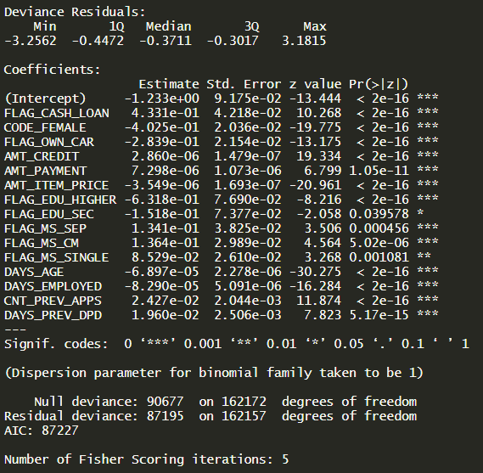
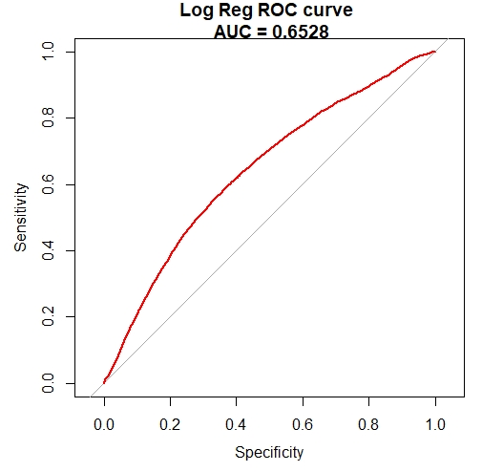
Logistic Regression Model
15 significant variables, including age, income, education status, etc.
Correct Predictions: 91.2% (at 15% threshold)
AUC: 0.6528

Slide 14
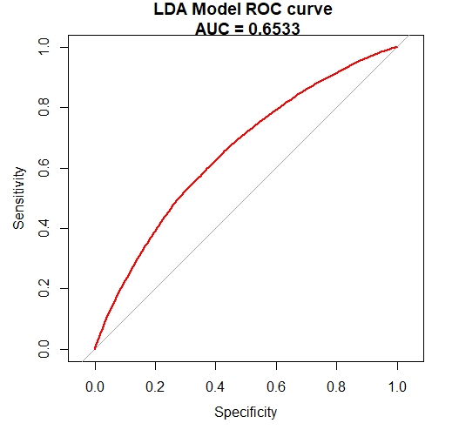
Linear Discriminant Analysis
15 significant variables, including age, income, education status, etc.
Correct Predictions: 92.08%
AUC: 0.6533

Slide 15

Quadratic Discriminant Analysis
Correct Predictions: 89.8%
AUC: 0.6421

Slide 16
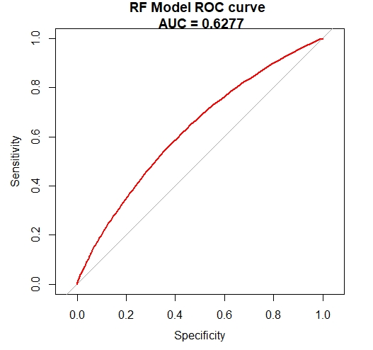
Random Forest Model
Correct Predictions: %60.3
AUC: 0.6277

Slide 17

kNN Model*
Correct Predictions: 86.2%
AUC: 0.6421
*Normalized data ( 0 -1)

Slide 18
Further Analysis
Use Gradient Boosting Machine (GBM) to improve accuracy
Utilize data from other tables in the dataset to add stronger predictors

Slide 19
Sources
https://www.kaggle.com/c/home-credit-default-risk/data
https://www.kaggle.com/willkoehrsen/start-here-a-gentle-introduction/notebook

